Slide 1

Account Management Agent
Moumita Laskar 5th July 2025

Slide 2
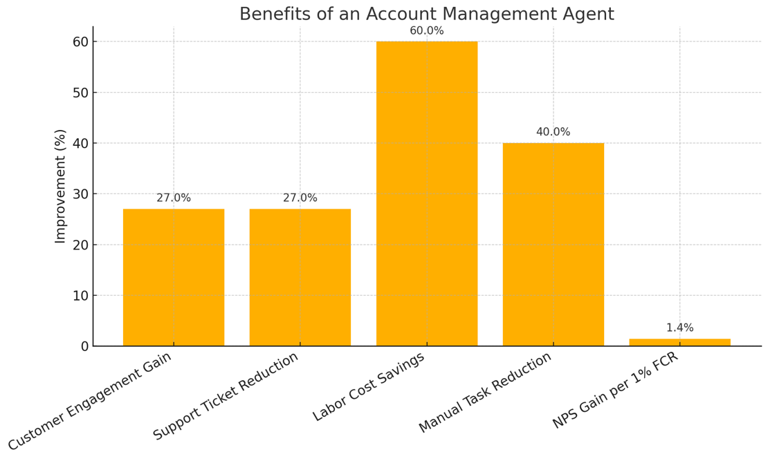
Account Management Agent : Introduction
Account Management is the ongoing process of supporting customers, understanding their needs, and helping them get the most value from your products or services.
Why we need Account Management Agent?
Improves Customer Experience
24/7 self-service for account updates (address, contact, password, email)
Faster resolution without waiting for human agents
Reduces Operational Costs
Automates high-volume, repetitive support tasks
Reduces human efforts to greater extent
Ensures Secure Transactions
2 Factor Authentication
Boosts Customer Retention
Builds trust through transparency and reliability
Supports Business Growth
Scales easily to handle increasing user base
Integrates with CRM and billing systems for personalized service
Agents to user should be simple, reliable, secured and robust
Sources:
https://kapta.com/resources/key-account-management-blog/key-account-management/moneyball-for-account-managers-what-the-stats-say-and-what-they-mean
https://www.gorgias.com/blog/customer-service-automation-guide
https://www.gorgias.com/blog/roi-automated-support
… < other sources >

Slide 3
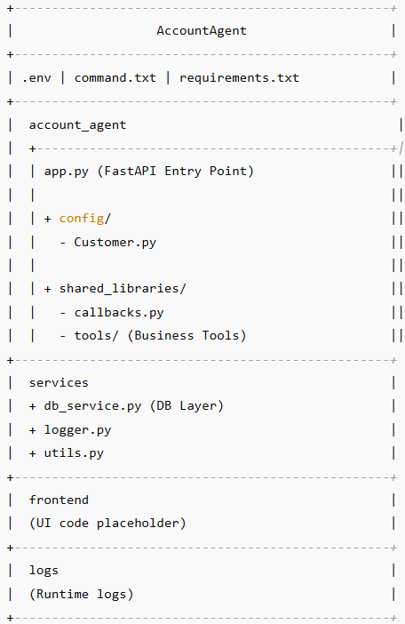
Project Structure Diagram
account_agent/
app.py: FastAPI app entry point
Environment settings and dependencies
config/
Customer.py: Customer session & config management
shared_libraries/
callbacks.py: before_tool_callback
tools/: Current supported tools
- create_account
- update_password
- update_email
- update_contact
- update_address
services/
db_service.py: Database interactions
logger.py: Logging configuration
utils.py: Utility functions
frontend/
Ui.py : Steamlit UI code
logs/
Application logs for debugging. The log name is
<session_id>_app.log
env, command.txt, requirements.txt

Slide 4
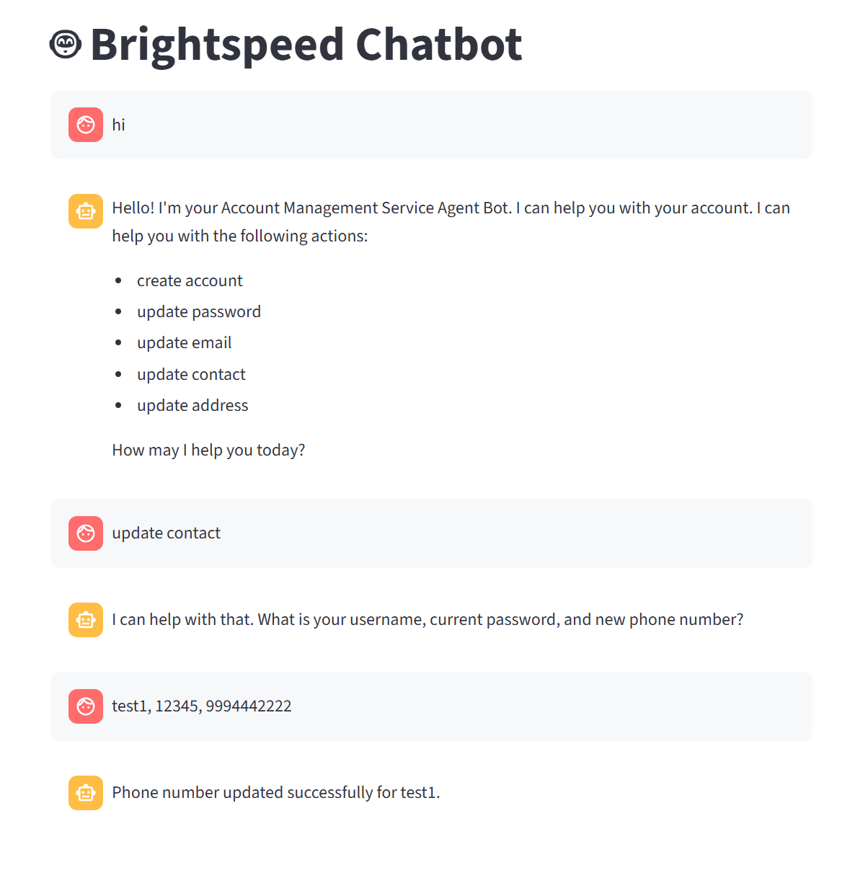
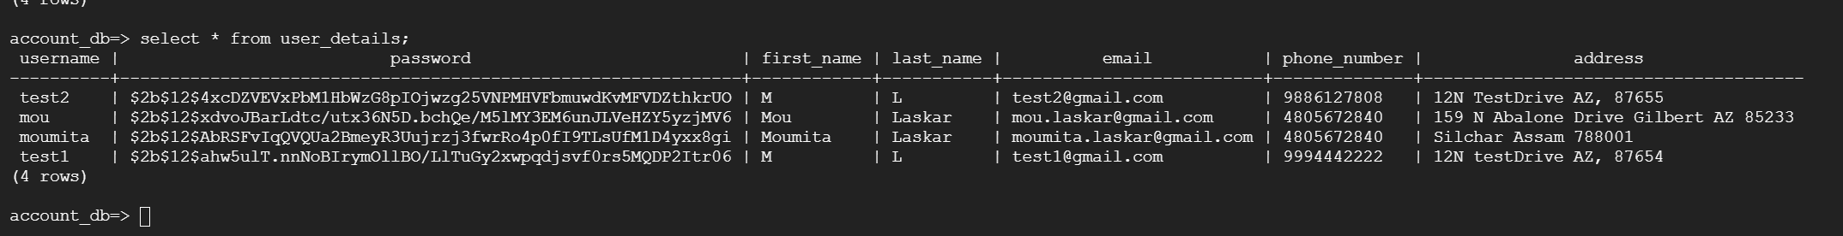
OUTPUT
The top right is the UI using streamlit
The bottom is the output in Google Cloud postgresql database
The username, email is unique for each individual
The password is encrypted and stored. Encryption is using psycopg2
When users enters password for authentication, it is encrypted and verified with password from database

Slide 5
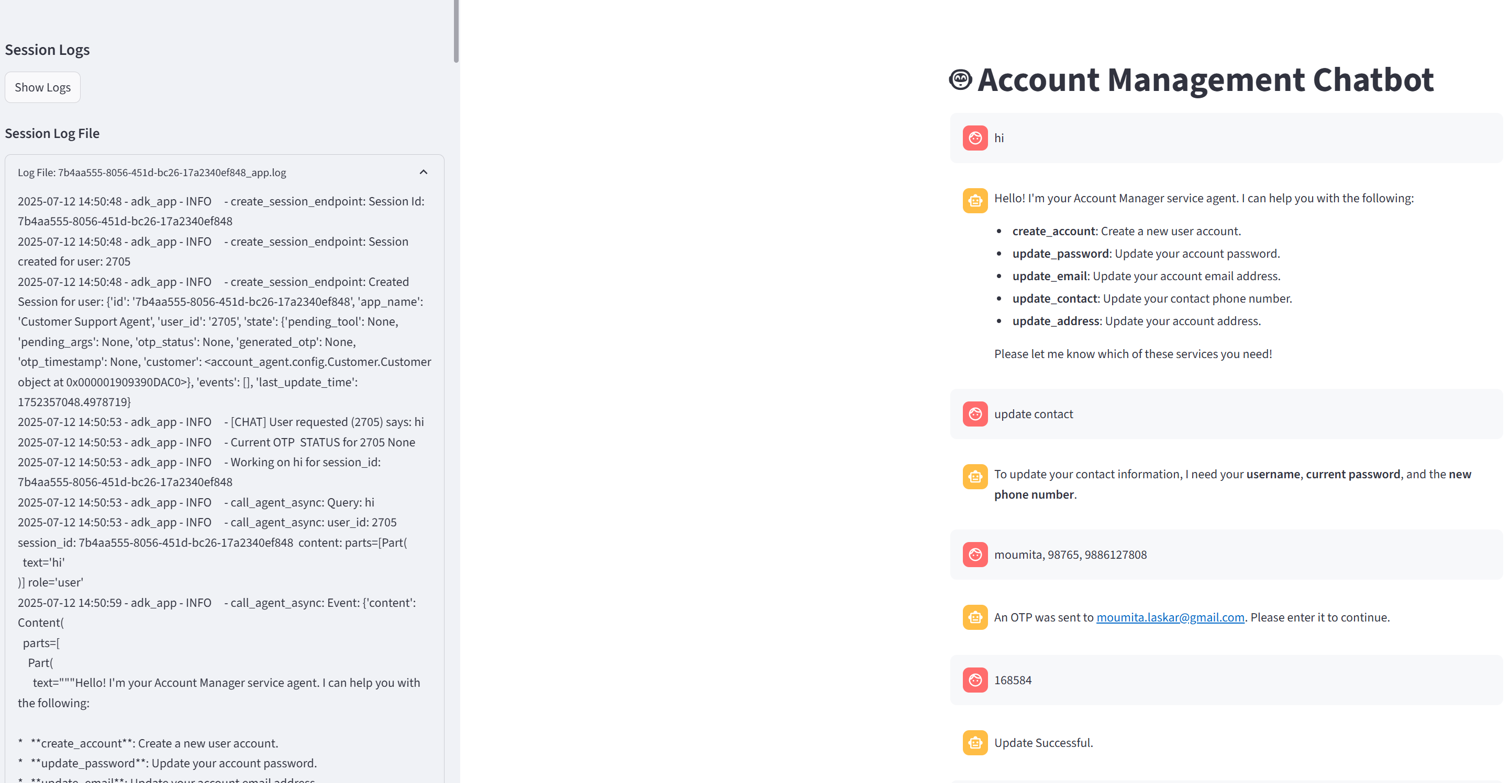
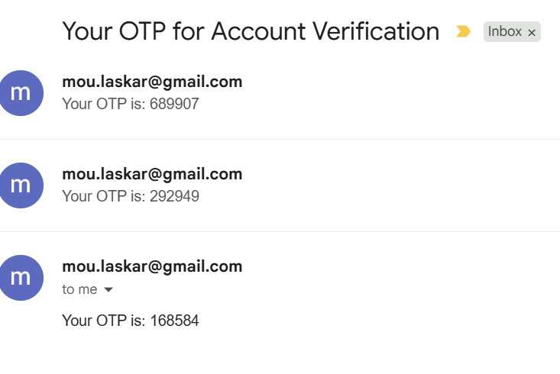
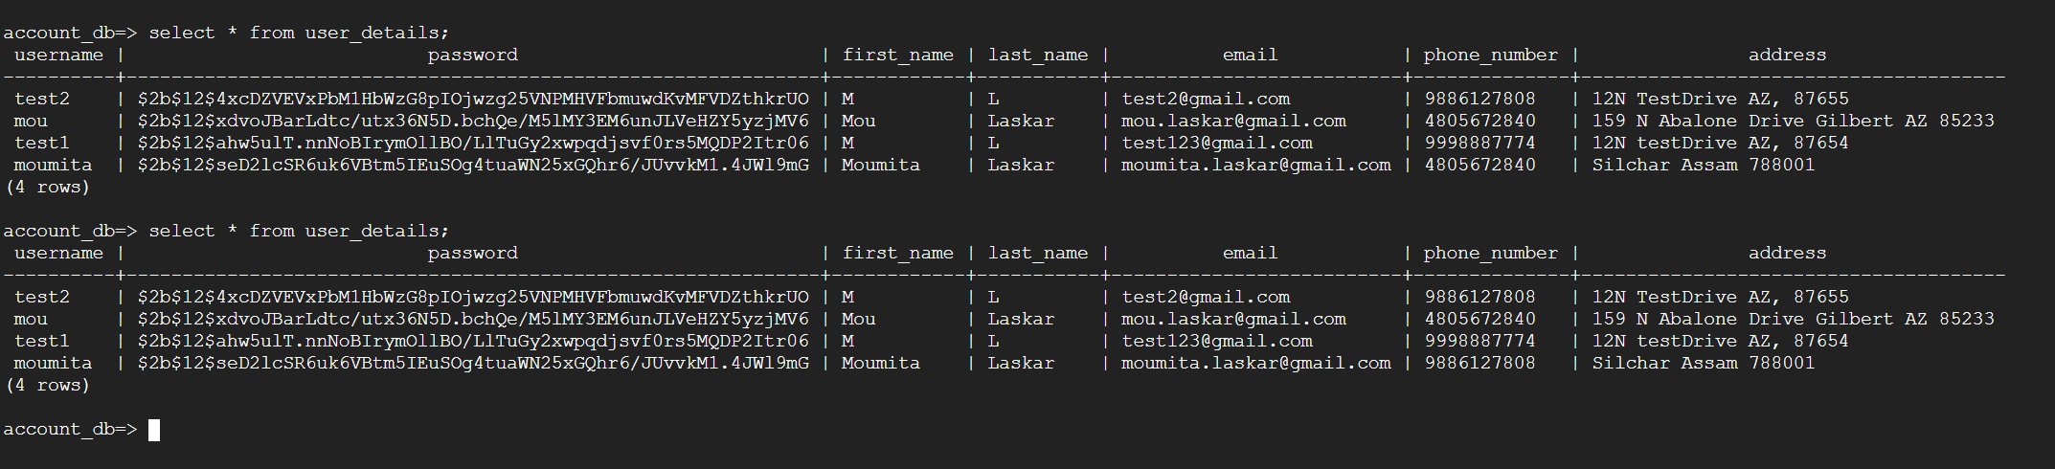
OUTPUT
The top right is the UI using streamlit
The bottom is the output in Google Cloud postgresql database
The username, email is unique for each individual
The password is encrypted and stored. Encryption is using psycopg2
When users enters password for authentication, it is encrypted and verified with password from database

Slide 6
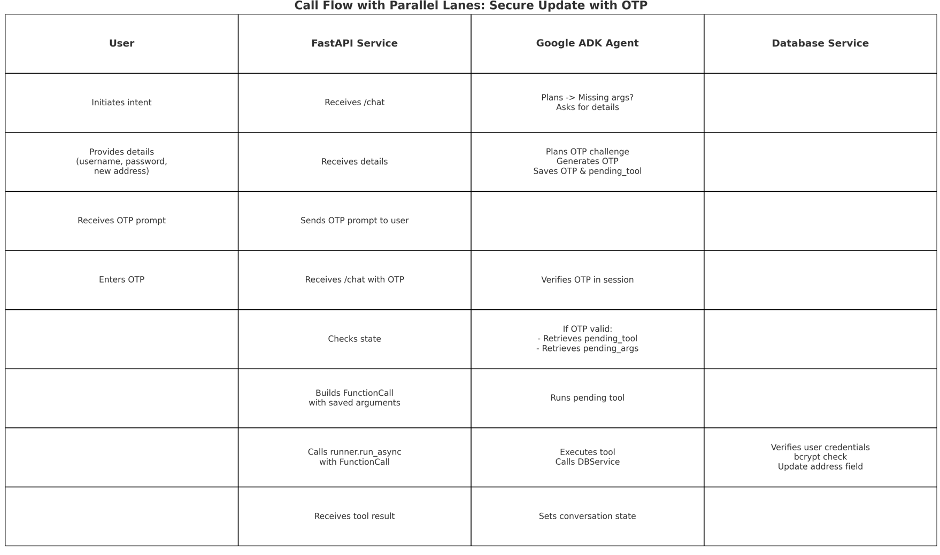
Overview of the working principles

Slide 7
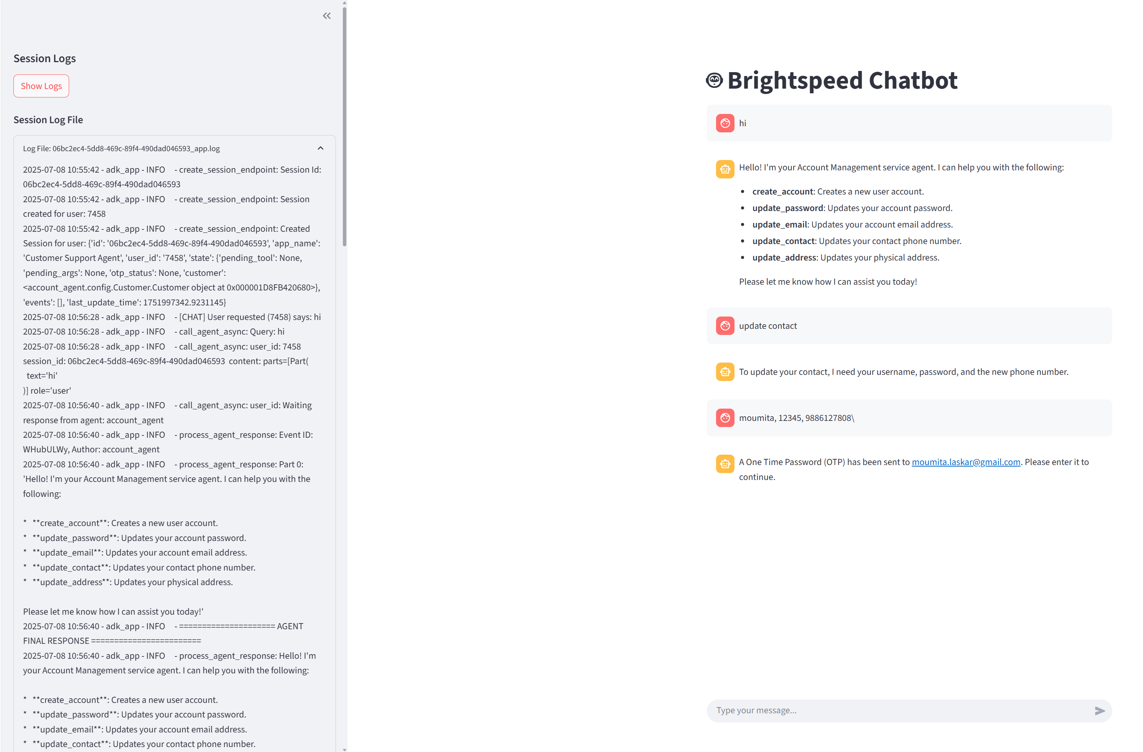
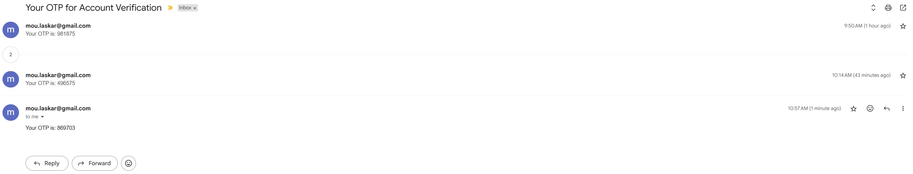
2 Factor Authentication – Work in Progress

Slide 8
Validation, Logging and Evaluation(ToDo)
Validate all required fields before proceeding:
Check for username
Check for password
Check for new value (e.g., new address, contact, email)
Logger Class to create log file for each session . Useful for debugging and checking status
Prevent crashes or unexpected behavior when fields are missing:
Avoid KeyError or TypeError during tool invocation
Return a clear, friendly error message to the user
Example Validation Pattern in Code:
kotlin
if not username or not password or not new_value: return "Error: Missing required fields. Please provide all necessary details."
Verify user credentials securely:
Use bcrypt hashing for password validation
Only proceed with update if authentication succeeds
Provide user-friendly feedback:
Inform user exactly which fields are missing
Suggest the correct input format if needed
Advantages:
Prevents invalid database writes
Improves user experience with clear guidance
Ensures security by enforcing credential checks
Maintains data integrity and consistency

Slide 9
Database Connectivity
psycopg2 | Model Context Protocol
- Uses standard psycopg2 Python library - Direct connection from FastAPI app to Google Cloud SQL (PostgreSQL) - Requires .env configuration: DB_HOST, DB_PORT, DB_USER, DB_PASSWORD, DB_NAME - SSL enforced via sslmode=require - Needs IP allowlisting in Cloud SQL - Suitable for: VM/Container deployments Predictable server IPs Custom database queries & session management | - Used in Google ADK for agent orchestration - Maintains conversation context - Manages tool calling - Shares session state across turns - Agent → Tool calls → External service (like DB) - Agent itself does not directly connect to SQL - Suitable for: - Structured AI workflows - Managing multi-turn dialogs with context - Calling external tools to access DB indirectly

Slide 10
Current Database Implementation
psycopg2 Connection Setup
Loads configuration from .env
Host, port, user, password, DB name
Connects to Google Cloud SQL over public IP
Enforces SSL for secure data-in-transit
Secure User Credential Handling
Passwords stored in DB as bcrypt hashes
User login verification uses bcrypt.checkpw()
Prevents storing plaintext passwords
Supports fallback for legacy plaintext entries during migration
Safe Parameterized Queries
Uses psycopg2.sql for safe dynamic SQL
Prevents SQL injection
CRUD operations with explicit field whitelisting
Advantages of Our psycopg2 Implementation
Simple and industry-standard
Easy to deploy in VM or container environments
Full control over SQL schema and queries
Secure, with SSL enforced and password hashing
Supports direct, low-latency DB access for real-time agent tools

